Slide 1

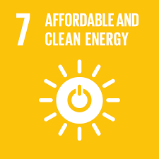
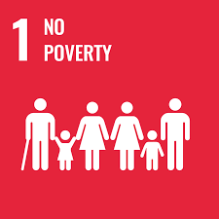


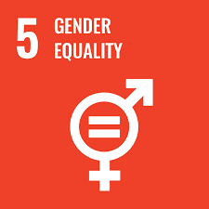
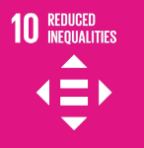




Problem
Inputs
Outputs
Outcomes
Impact
Insufficient infrastructure and value chains for electricity supply
Grant financing to
private & public sector
Business development
New private and public financing leveraged
Widespread use of polluting cooking methods
Reduced poverty and inequality in a green world
Results-based finance
Human capital development
Installed on-grid renewable energy generation
Avoided emissions through increased renewable energy supply
Low ability to pay for energy services
Increased access to electricity and clean cooking technologies
Increasing GHG emissions from energy production and use
Risk mitigation (e.g. guarantees)
Improved information basis for sector development
Strengthened electricity networks
Sustainable economic development improving living conditions and welfare, while promoting climate, environment and nature.
Inadequate legal/ regulatory framework and governance challenges
Strengthened institutions and improved governance and transparency
Technical and transactional assistance
Effective regulations and policies
Enhanced market for off-grid electricity and clean cooking
Insufficient public and private investment in energy sector
Capacity building and twinning arrangements
Strategic partnerships and policy dialogue
Improved capacity for
power trade
Lack of institutional capacity for energy system planning
Assumption and prerequisites for moving between ToC stages
Necessary financing made available
Financing can be absorbed into local context
Appropriate program design
Inputs are demand driven and well coordinated with other initiatives
Knowledge-sharing and policy dialogue is effective and suited to improve regulatory context, making it more conducive to investments
The political economy in partner countries is adaptive and open to change
Financing is effectively utilized
Sufficient absorption capacity in public institutions
Behavioral change interventions are effective
Local workforce can be absorbed by new sectors
Access to energy leads to use, i.e. electricity and clean cooking solutions are affordable, available, reliable; and appropriate to local contexts
Available electricity is put to productive use and income-generating activities
Increased and improved employment opportunities, leading to higher incomes
Businesses benefit from electricity and can expand activities
Increase in welfare through improved and prolonged leisure time
Electricity use leads to increased study time and school quality
Electricity use leads to more effective public healthcare services
Clean cooking technology improvement in air quality is sufficient to improve health
Interventions effectively target women and girls as beneficiaries
Clean energy and clean cooking replaces dirty energy and cooking

