Slide 1

FfD4 and the Future of Data: Strengthening Systems for Sustainable Financing
A Sevilla Platform for Action initiative

Slide 2

This is a meeting to discuss how we best can implement the Sevilla Platform for Action (SPA) initiative FfD4 and the Future of Data: Strengthening Systems for Sustainable Financing
Bringing together countries and entities that either have endorsed or consider endorsing this SPA
Co-led by Colombia, Norway and the UK

Slide 3
Agenda
Welcome
Introduction to the SPA and its main pillars
Q&A
Break-out groups
Plenary feedback
Way forward/roadmap
Closing

Slide 4
SPA objective
Strengthen data/statistics systems to better inform the FfD4 agenda, including:
enhancing domestic resource mobilization,
optimizing international development cooperation,
Supporting debt sustainability
Addressing systemic issues
Meeting objectives
Provide more information about this SPA
Discuss how to best take the SPA forward
Bring together those who need better data/statistics and those who produce

Slide 5

Sevilla Commitment
In the Sevilla Commitment increased emphasis was put on the importance of strengthening national data and statistical systems to better inform decision making in the financing for development context
Paragraph 23:
We recognize that high-quality and disaggregated data and statistics enable evidence-based policy decisions and enhance accountability and transparency, fostering public trust and international cooperation. We will support programmes that strengthen national data collection and statistics, especially on sustainable development.

Slide 6
Paragraph 63:
To enhance investment in data and statistical systems, building on the Cape Town Global Action Plan for Sustainable Development Data:
We will continue to strengthen our efforts to collect, analyse and disseminate relevant and reliable data disaggregated by income, sex, age, race, ethnicity, migratory status, disability, geographical location and other characteristics relevant in national contexts, including to achieve gender equality and the empowerment of all women and girls;
We commit to the implementation of the Medellín Framework for Action on Data for Sustainable Development adopted by the Statistical Commission in March 2025;
We commit to increase financial support to, and enhance investment in, data collection and statistical capacity-building of national statistical systems in developing countries, especially countries in special situations and those facing specific challenges. We will scale up predictable financing for sustainable development data and statistics, upgrading digital infrastructure and strengthening data collection, statistical capacity and digital governance. This includes support for the Small Island Developing States Centre of Excellence, including the small island developing States data hub, and existing statistical initiatives, including through regional organizations.

Slide 7
Where are we now?
The Sevilla Commitment has helped change the narrative around data and statistics - from accountability to action
…but it hasnt solved the how we achieve the change.
The FfD4 and the Future of Data SPA will focus on how we bring the commitment to life - how we deliver against that recognition.

Slide 8
Poll
What are the most important priorities for strengthening data/statistics for financing for development?

Slide 9
FfD4 and the Future of Data: Strengthening Systems for Sustainable Financing
Data and statistics are strategic assets and force multipliers for development finance.
Smart investments in data help governments raise revenue, manage debt, unlock private capital, and coordinate international assistance more effectively.
The FfD4 outcome document acknowledges the importance of data. But recognition alone won’t drive results. Collective action, building on the foundations of successful data initiatives and partnerships, will enable delivery of commitments and priorities for data and statistics within the renewed global FfD framework.

Slide 10
The SPA has three pillars
Efficient Data Financing Fragmentation of investment, overreliance on short-term approaches, and poor coordination undermine results and waste resources. Efficient financing requires aligning support with national priorities, harmonizing funding streams, and maximizing impact through collaboration.
Future-Proofing Data Investments Data systems must evolve with today’s demands- digital economies, inclusive growth, people and planet all require flexible, tech-ready systems and fit-for-purpose, AI ready data. Future-proofing means scaling what works and adapting quickly to new challenges, guided by national leadership.
Political Commitment and Cross-Sector Coordination Success depends on high-level support. Ministries of finance, planning and statistics must work together, backed by partners committed to breaking silos and building shared accountability.

Slide 11
Further splitting the pillars into key topics
Pillar 1: Efficient data financing
Group A: Enhancing domestic resource mobilization
Group B: Optimizing international development and south-south cooperation
Pillar 2: Future-Proofing Data Investments
Group C: What inputs do we need to future proof data investments? (legal, methodological, quality etc.)
Group D: What outputs would be most relevant for future proofing? (platforms, open data, AI etc.)
Pillar 3: Political Commitment and Cross-Sector Coordination
Group E: Strengthening links between government entities for FfD purposes
Group F: Strengthening links between producers and users across government, civil society, academia and private sector for FfD purposes
Group G: Coordinating development support between international agencies.

Slide 12
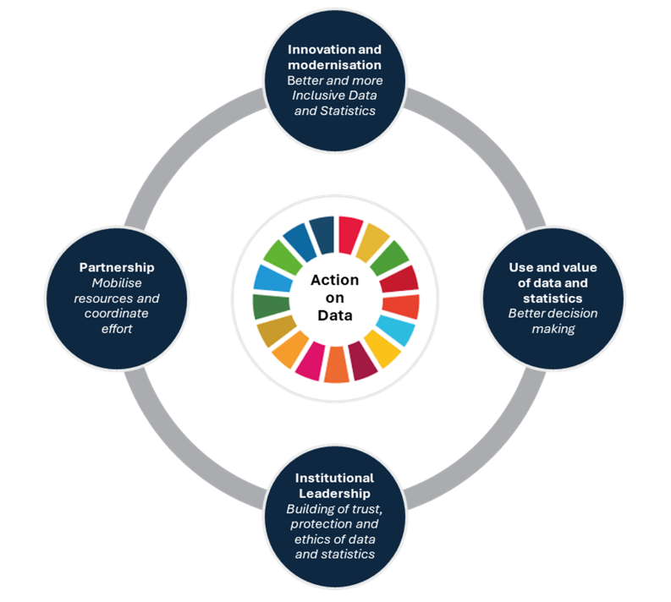
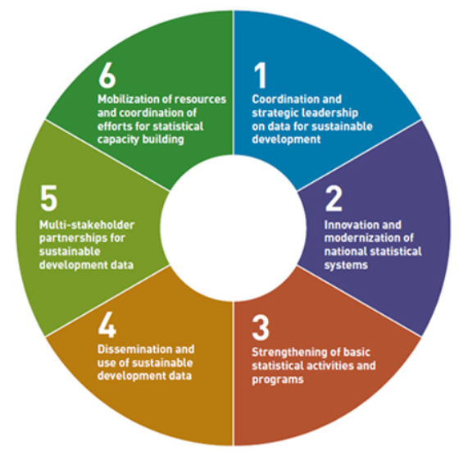
Strategic frameworks to build upon
Cape Town Global Action Plan
Medellin Framework
Notes:
Make reference to para 63 from the Sevilla Commitment

Slide 13
Collaborative at country level
A key challenge in many countries is the lack of a well-functioning data ecosystem
The SPA aims at strengthening links across data producers and with those who need data and statistics for decision making
The SPA is also intended to bring partners together to support national system strengthening
We generally hope to have representatives involved from both the FfD and data/statistics communities

Slide 14

Key actors
Member states/governments
Ministries of Finance/Economy/Planning
National Statistical Offices
Revenue Authorities, Central Banks
Other members of the National Statistical System
Donors and investors
Ministries of Foreign Affairs/Donor agencies
South-south cooperation
Investors
Partners – multilateral actors
Global
Regional
National
This Photo by Unknown Author is licensed under CC BY-SA-NC

Slide 15

Endorsement
We welcome additional endorsements
To ensure linkages to FfD, country endorsements should be made at high level such as by Ministries of Finance or Planning
Focal points can be at more operational level
Send endorsement to: Colombia, Norway and/or UK

Slide 16

Q&A

Slide 17
Group work
Move into 7 different break-out groups. All participants should have been pre-assigned
One facilitator and one note taker per group
Specific guiding questions per group

Slide 18
Look at the core challenges
What are the current gaps in addressing core challenges?
Where do we have initiatives and tools that can address some of these?
What/which approaches need to be adapted?
What needs to be built forward?
How can you contribute to address the challenges?
We need to lift the lens and work across communities (financing for development, data governance, statistics etc.)
Focus on what can be achieved with existing resources
Notes:
How do we take advantage of higher level meetings? (WB spring meetings, IMF high-level meetings etc.)
How do we take advantage of key FfD structures, such as the INFFs?

Slide 19
Group moderators
Group A: Enhancing domestic resource mobilization:
Pia Rattenhuber, UNU-WIDER
Group B: Optimizing international development and south-south cooperation
Vibeke O Nielsen, Norad
Group C: What inputs do we need to future proof data investments?
Faryal Ahmed, UN Statistics Division
Group D: What outputs would be most relevant for future proofing?
Fredy Rodriguez, Global Partnership for Sustainable Development Data
Group E: Strengthening links between government entities for FfD purposes
Camilo Mendez, DANE Colombia
Group F: Strengthening links between producers and users across government, civil society, academia and private sector for FfD purposes
Maryam Rabiee, Sustainable Development Solutions Network
Group G: Coordinating development support between international agencies.
Deirdre Appel, Open Data Watch

Slide 20
Plenary feedback
Each moderator highlights key point from group discussion (2 min each)
More details will be summarized in the meeting report
Brief open floor for additional input from other participants

Slide 21
Way forward
Develop a roadmap
Further define structure and goals based on todays conversation
Define who contributes and how
Specify key meetings for discussion and wider engagement, including HLG-PCCB and UN Statistical Commission
Agree on a main product to present at the FfD Forum in April 2025

Slide 22
Thank you
Contact us:
Colombia: Camilo Mendez camendezc@dane.gov.co
Norway: Vibeke O Nielsen vibeke.oestreich.nielsen@norad.no
UK: Paula McLeod paula.mcleod@fcdo.gov.uk

