Slide 1
Beating the DRUM for UHC
Christoph Kurowski, Global Lead Health Financing,
The World Bank Group
Oslo, November 5, 2018

Slide 2
WHAT IS DRUM FOR UHC?
DR
U
M
DOMESTIC
RESOURCES
USE
MOBILIZATION

Slide 3
The UHC goal will slip out of reach unless we address the challenge of health financing.
Notes:
Approaching fast a turning point / critical juncture on the path to UHC
The goal of UHC will slip out of reach unless we address the challenge of health financing: DRUM
Relates to both domestic resources and international donor assistance

Slide 4
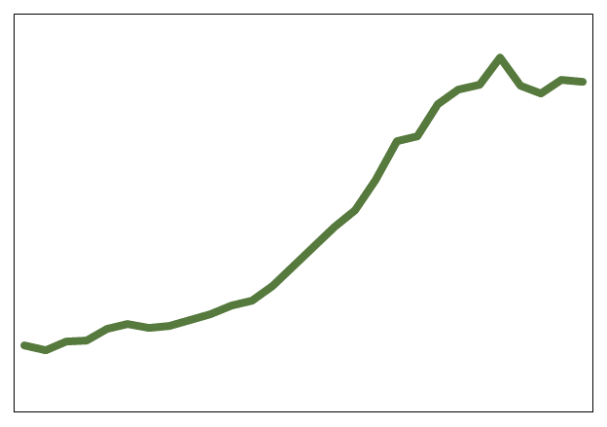
WHAT IS HOLDING BACK PROGRESS?
LMICs
$117
LICs
88%
2030
$90
$25
$7
8%
2015
2015
INADEQUATE MOBILIZATION
STAGNATING DAH
INEFFICIENCY
INEQUITY
M: MOBILIZATION
U: RESOURCE USE

Slide 5
THE DRUM FRAMEWORK
LEARN FROM THE PAST
THE DRUM
FRAMEWORK
BRING THE FUTURE TO THE PRESENT
Notes:
Add some questions.
Here is what governments need to discuss.
Body of background … learning from the past. What do we have to learn.
What will it make to make this success stories the rule and not the exception. Learning from the past is not enough. Let me demostrate this. Using the M from Mobilization, so much is needed in 2013.

Slide 6
THE DRUM FRAMEWORK
LEARNING FROM THE PAST
HEALTH FINANCING STEWARDSHIP
What are the key issues amenable to change?
What are the most promising solutions?
What are the barriers?
What are the practical options to move forward?
Joint leadership
Stronger health financing institutions and capacity
Accountability
COMMON THEMES

Slide 7
THE DRUM FRAMEWORK
MORE IS NEEDED
$48
$7
2015
LICs
$13
2023
$70
2015
$25
LMICs
2023
$56
Notes:
Curves up for the favorable assumptions
START WITH BENCHMARK AND WHAT IS NEEDED AND HOW IS CALCULATED

Slide 8
THE DRUM FRAMEWORK
BRING THE FUTURE TO THE PRESENT
Which health financing problems have the greatest potential for change?
Which innovations are most promising?
How can innovations be adapted and tested?
How can successful pilots be taken to scale?
INCREASE TRANSPARENCY AND ACCOUNTABILITY
CASHLESS PAYMENTS
REDUCE FRAUD AND CORRUPTION
EXPAND FINANCIAL PROTECTION
DATA FOR POLICY MAKING

Slide 9
WHAT WILL IT TAKE?
STRENGTHEN SOCIAL
& POLITICAL DEMANDS
JUMP-START PROGRESS WITH EFFICIENCY GAINS
TAP PRIVATE SECTOR INNOVATIONS
TRANSFORM HEALTH-PARTNERSHIPS
Improved accountability
Win-win solutions
Public Private Partnerships
Joint financing reviews
Notes:
Reframe.
This is what we propose in the DRUm approach.
Co-host have identified some areas to spark the debate. In the preparation of the background report, they are only seen as to spark the debate.

Slide 10
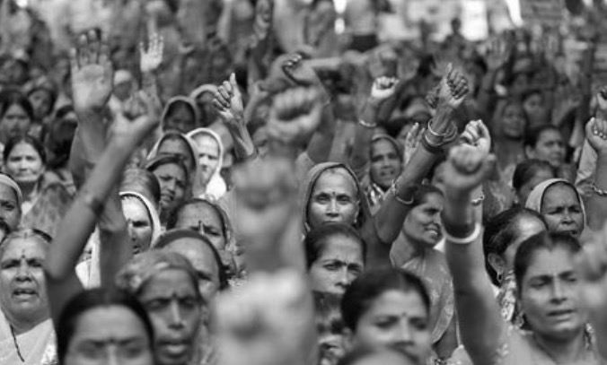
Notes:
Approaching fast a turning point / critical juncture on the path to UHC
The goal of UHC will slip out of reach unless we address the challenge of health financing: DRUM
Relates to both domestic resources and international donor assistance

