Slide 1
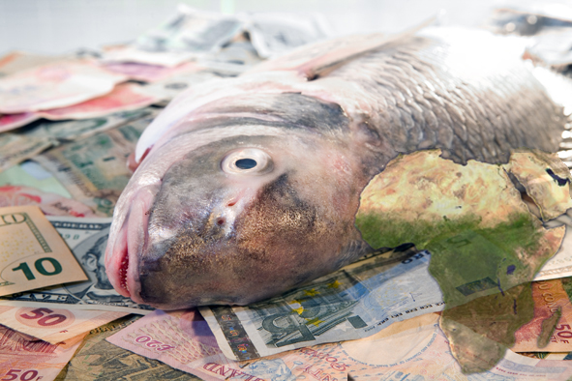
Identification of potential aquaculture and fish processing investment projects and partners in selected countries in Africa
Work conducted between mid 2008 – early 2009
NFDS: James Muir
Sandy Davies
Per Erik Bergh
Econ: Emelie Aurell
Audun Gleinsvik
Sveinung Fjose
Notes:
Team – Who is here
Responsibilities of companies
Timing mid 2008 to 2009
Client NORAD but with the Norwegian investor in mind

Slide 2
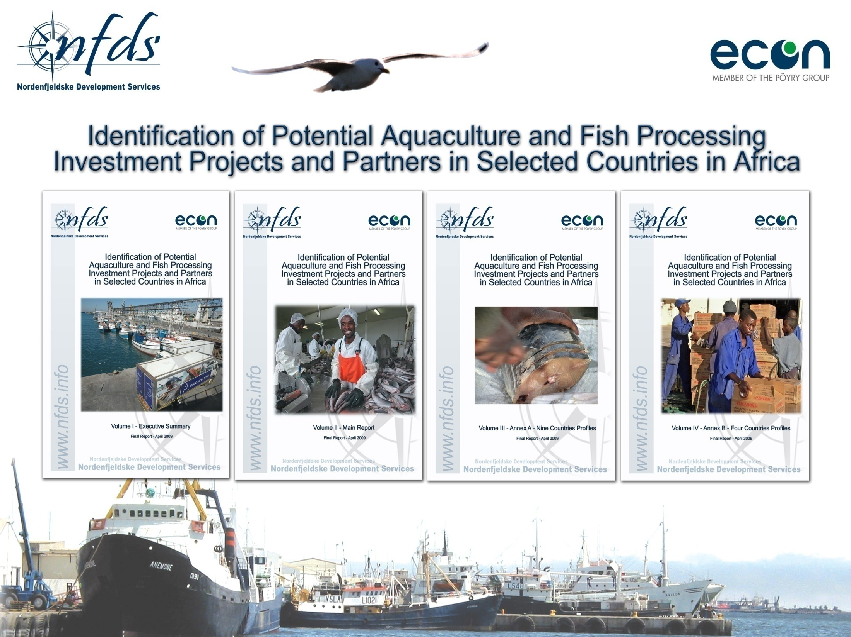
http://norad.no/en/Tools+and+publications/Publications/Publication+page?key=125664
Notes:
4 reports are available
They contain the detail – lots of it
Today we are providing an overview and taste of the reports only

Slide 3
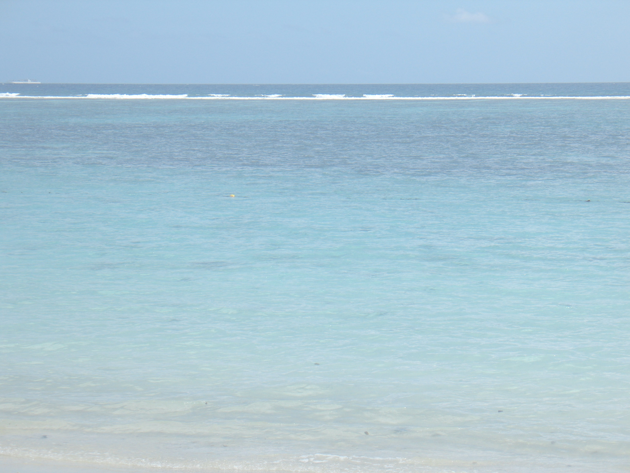
The African fisheries and aquaculture sector
Fishery resources are of great social and economic value to Africa - but are by many considered to be largely unrecognised and not utilised to their full potential.
About 200 million people – 30 % of the continents population- eat fish as their main source of animal protein.
High value fish exports have rapidly increased. In 2006 African exports amounted to USD 4.0 billion. Fisheries is the leading agriculture export commodity for Africa, above coffee, sugar and bananas
Aquaculture is today more or less equal to capture fisheries in terms of fishery production world wide. But... in Sub-Saharan Africa aquaculture only supplies 3 % of fish production.
Only to meet local demand, aquaculture in Africa has to increase by 270%. There is also potential for export oriented aquaculture production.
Aquaculture is very much at it beginning in Africa, despite its large potential. Possible explanations may be a complicated business and investment environment.

Slide 4
The character of Norway’s international engagement
There have been long established catching and trading connections.
The success of the salmon aquaculture industry has given a particular incentive to this.
Technical innovation, expansion of output and market development = key features of Norway’s international presence in the fisheries and aquaculture sector.
Investment confidence in the sector has tended to be cyclic, possibly due to Norwegian stock market expectations being driven by more localised perceptions.
An increasingly large part of the Norwegian value chain in aquaculture has been internationally focused.
The move for Corporate Social Responsibility is becoming increasingly important.
Norway also has an active and well regarded R&D capacity - has already shown strong interest and good impact in various linkages with developing country issues.
The fishing and aquaculture industries are considered “high” risk by several Norwegian and Scandinavian banks.
Norfund has several investments in aquaculture in developing countries. However, due to poor results, they are now more restrictive towards re-entering the sector.
Notes:
International but conservative

Slide 5
Where is Norway investing – Africa?

Slide 6
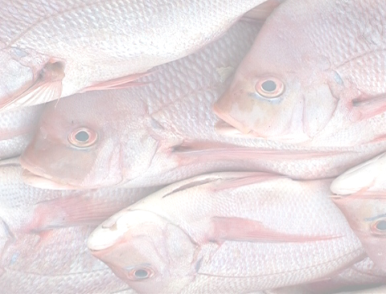
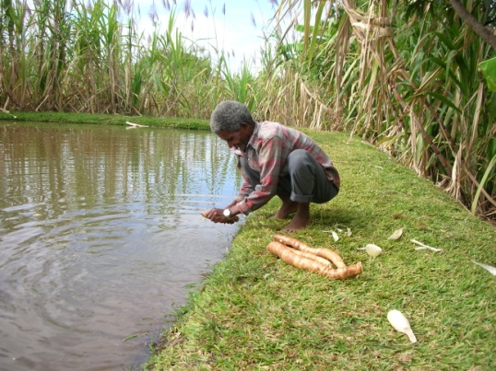
Initial screening of investment potential in Africa.
In order to identify countries with best resource base, investment and trade environment, the study ranks African countries related to :
  Natural and biological environment of fisheries (FAO statistics combined with own assessment)
  Environment for aquaculture (FAO Statistics and own assessment)
  Environment for business development and foreign investment (Doing Business Reports)
    We have weighted the ranking, giving more importance to factors perceived to be important to Norwegian Investors (trading across boarders, registering property)
  Political risk and stability, including governance (OECD, The Belgian Export Credit Agency)
  Governments’ intentions and encouragement in relation to regional and international trade

Slide 7
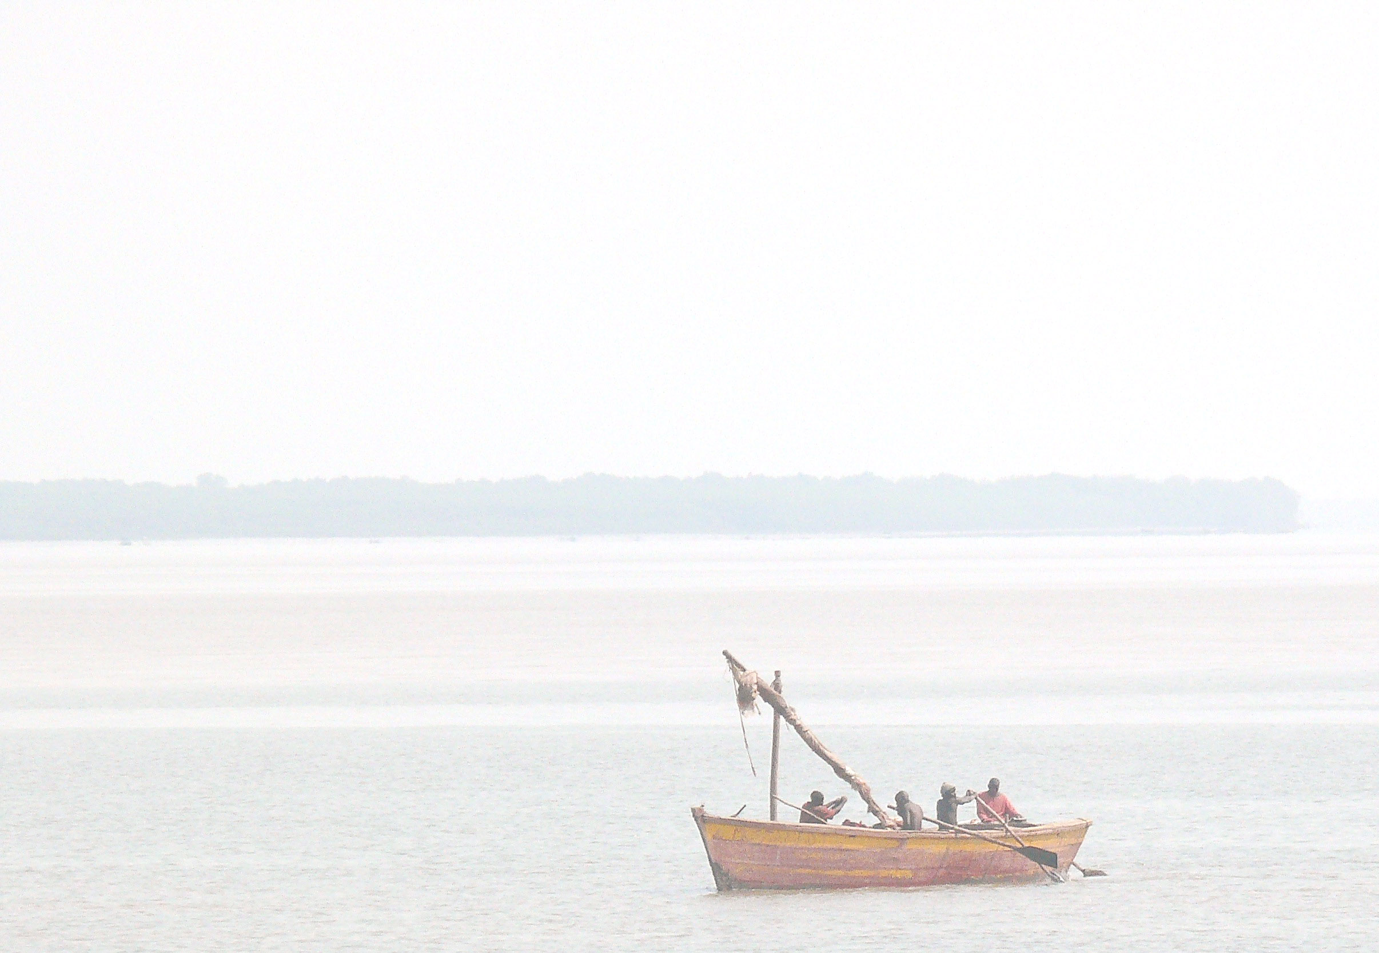
Fishery Export (USD)
Country | Total production | Capture fisheries | Aquaculture | Fishery imports | Fishery exports
 | 2007 (t) | 2007 (t) | 2007 (t) | 2006 (USD 1,000) | 2006 (USD 1,000)
Egypt | 1,008,008 | 372,492 | 635,516 | 167,741 | 3,495
Ghana | 321,875 | 320,725 | 1,150 | 125,321 | 51,956
Kenya | 136,203 | 131,963 | 4,240 | 8,391 | 55,798
Mauritius | 8,476 | 7,906 | 570 | 214,748 | 160,250
Mozambique | 93,177 | 92,270 | 907 | 31,781 | 96,698
Namibia | 415,570 | 415,518 | 52 | 20,204 | 458,531
South Africa | 682,960 | 677,171 | 5,789 | 152,952 | 406,069
Tanzania | 329,711 | 329,301 | 410 | 1,077 | 188,782
Uganda | 551,110 | 500,000 | 51,110 | 374 | 146,951
Source: FAO 2009

Slide 8
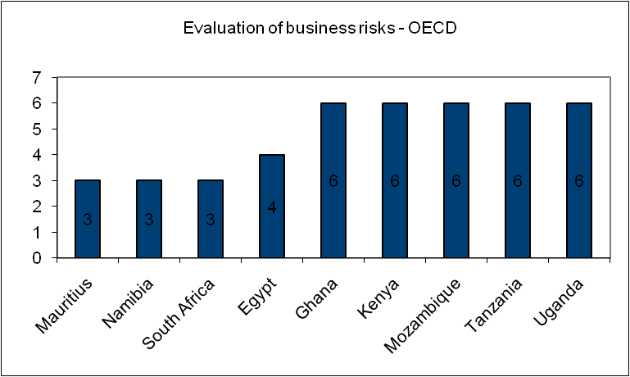
Business Risk

Slide 9
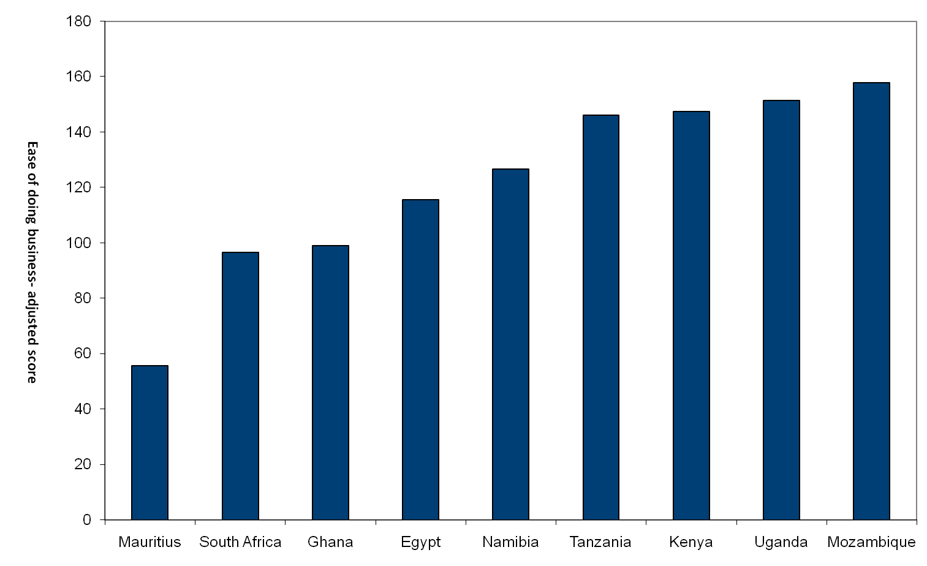
Ease of doing business – Norwegian fishery adjusted score

Slide 10
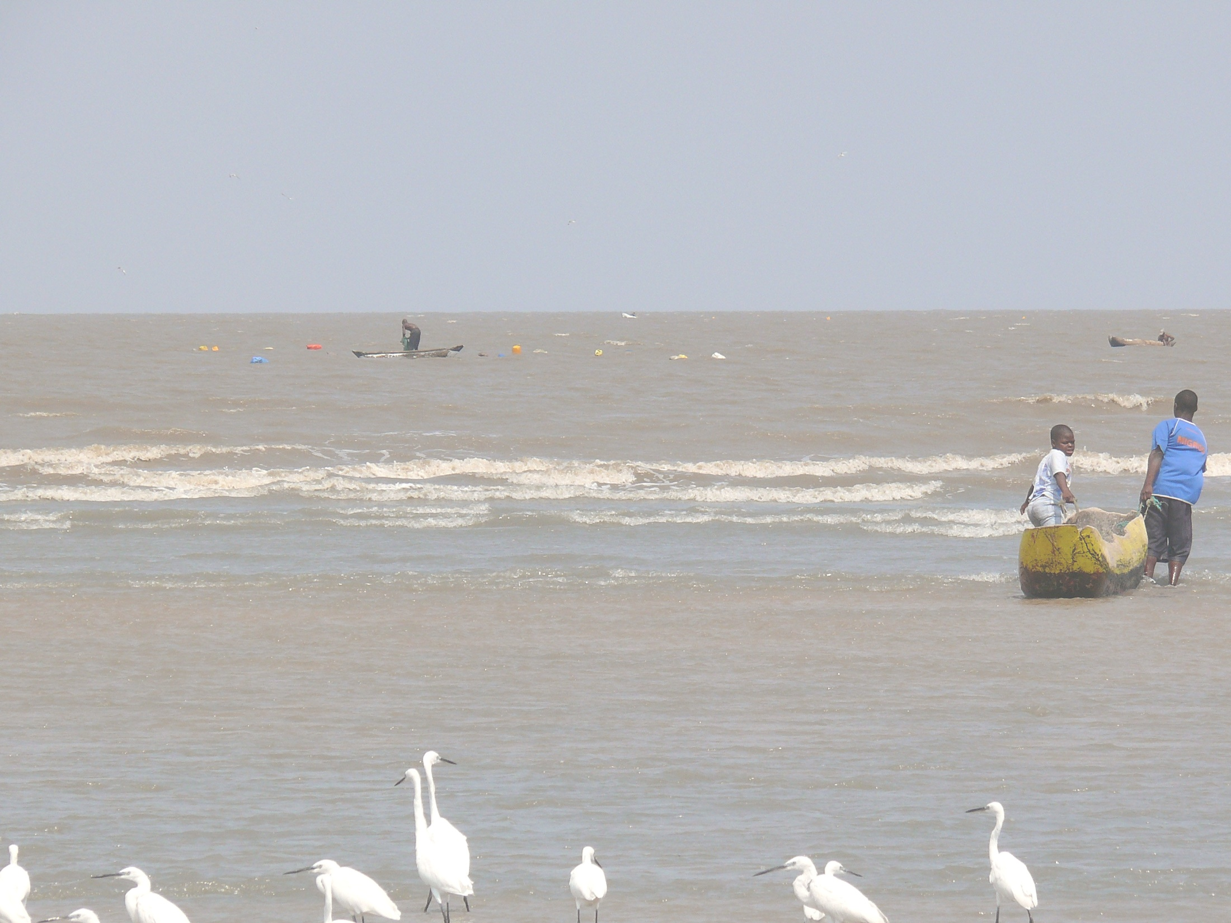
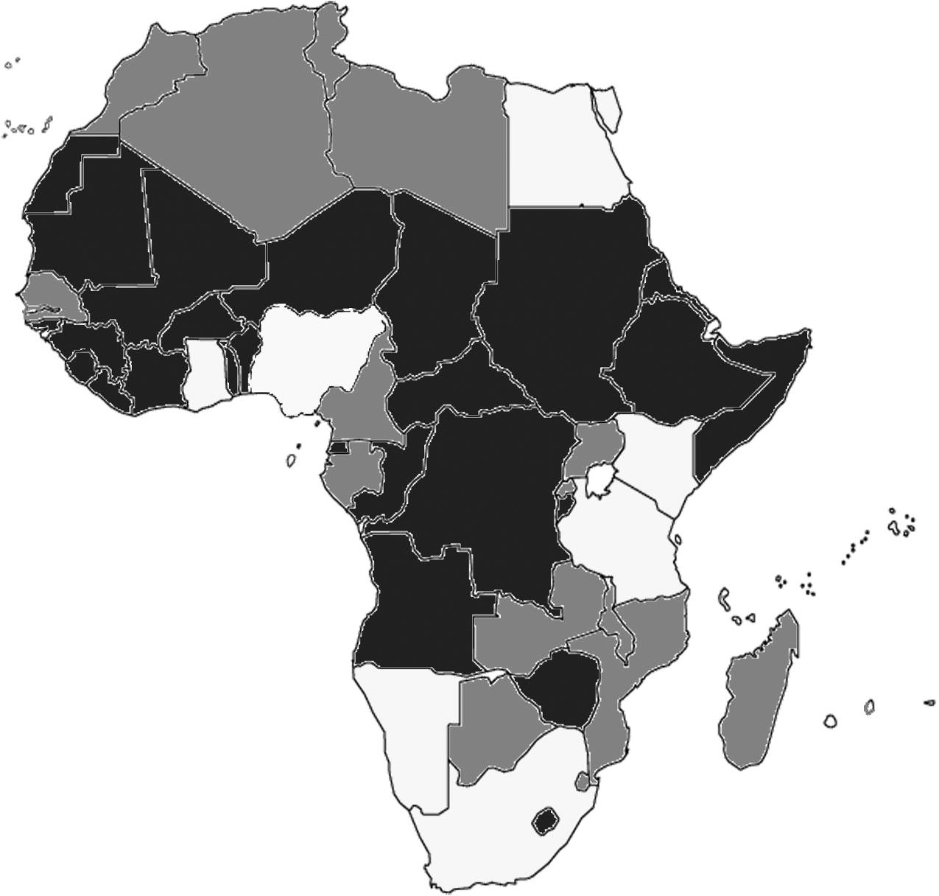
Ranking of countries
Good to high score – low risk and good potential for fisheries and aquaculture | Medium score – medium risk with reasonable options for either fisheries or aquaculture | Poor score – high risk and limited possibilities for aquaculture or fisheries
Notes:
Not surprisingly the sahara is not so big nor the less politically stable countries with often over fished resources

Slide 11
Selection of field visit countries
Country | Business rating | Resource/export | Presence/interest | Notes
Ghana | High | Medium-high | Medium-high | Overall positive choice
Mauritius | Low | Medium-high | High | Overall positive choice
Tanzania | Low | Medium-high | Medium-high | Useful choice and good prospects for change
Uganda | Low | Medium | Medium | Possible choice but some constraints
Mozambique | Lowest | Low-medium | High | Possible choice mainly social impacts.
South Africa | High | High | Medium-low | Useful choice but not highest ranking – new impact limited
Namibia | High | High | High | Useful choice but less opportunity for new directions
Egypt | Medium | High-low | Low-medium | Little attraction
Kenya | Low | Medium | Low | Little attraction
Notes:
Selection was not based on ‘most probably’ alone it was a decision to include a range of countries with different overall options

Slide 12
Opportunities for 5 countries not selected
Egypt (aquaculture): The overall perspective - unless there were specific pre-existing business linkages, the potential returns would probably be insufficient to merit further attention.
Kenya: Political and economic conditions improving = signs of increasing investment confidence in Kenya, resources are relatively good, and a rising economy will increase domestic demand and purchasing power.
Mauritius: Mauritius is an attractive location, good reputation for its seafood, increasing aquaculture sector. EU assistance in production support and value addition - well positioned to build sector.
Namibia (aquaculture): Major resource base and trading position, good governance and very positive government support for sectoral development, proactive approach to aquaculture.
South Africa (aquaculture): large and diverse economy, strong marine fishery resource base, markets, infrastructure and comms well developed, need local partners and joint ventures.
Notes:
Egypt – aquaculture only
Major scale agro-industrial development possible
Major land / water rights
But too much competition and home grown
Kenya
Improving situation – similar to Tanzania – new Ministry and Minister...
Increasing economy – tourist sector
The 2008 violence not sorted ..... But many potentials similar to Tanzania and possible links
Mauritius
Big EEZ – mostly tuna fished by DWFN, IUU issue, don't catch much locally buy it in
Attractive location (that’s why NORAD wouldn't let us go there)
Good reputation seafood – quality
Growth potential in aqua and tuna processing / value addition
Friendly business environment
Namibia and ZA
Major fisheries
Developing aquaculture sectors
Namibia strong policy and government interest
Positive sectors
ZA a bit more politically unstable
Need partners
BUT lots done ...... Easy information and contacts for the potential investor .... Highly recommended to look into but NORAD, trade council have done enough .... Time for new ground.

Slide 13
Focused Country Reviews
Tanzania, Mozambique, Ghana, Uganda
Context-setting to clarify opportunities
    Specific investment climate/sectoral features
    Resource and management conditions
    Scale of enterprise, risks and levels of return
    Possible ‘turning points’ – policy, resource, technology, markets
    Rate at which business could develop
    Existence/quality/interest of partners
    Responsible practice and ‘good citizenship’
Types of enterprise – primarily medium to larger scale commercial, also possible CSR e.g. for energy, agribusiness, telecoms, plus smaller scale personal/NGO links
Discussions across range of sectoral agents, technical and business interests
Notes:
Context-setting to clarify opportunities – TYPE, SCALE, RISKS, RETURNS – of potential business models
Specific investment climate/sectoral features – broad characteristics and options
Resource and management conditions – quite and issue for fisheries
Scale of enterprise, risks and levels of return – risks – biological/techncial, markets/economic, social/political – can they be managed if exist?
Level of return – eg CSR less but broad benefits
Possible ‘turning points’ – break through points – eg trade access, SADC union, new access to resources or land
Rate at which business could develop – any incentives
Existence/quality/interest of partners -
Responsible practice and ‘good citizenship’ – both the quality of investment, we discarded quick speculative investment and as assume that the Norwegian investor is a good citizen, pollution, social etc
Types of enterprise – possible areas of commercial investment, competitive return, positive cash flow sooner than later and longer term strategic investment

Slide 14
Type and scale of enterprise options
Enterprise type | Characteristics | Value addition | Aquaculture | Services
Large commercial sector | Internationalised, large output and turnover, major resource user, globally competitive, higher technologies and meeting international standards | Major processing and export businesses – e.g. tuna, tilapia, Nile Perch – fresh, freezing, filleting, canning output 2-10,000t/yr, value USD 3-50 million/ yr | Major single or multi-site producer, e.g. tilapia, usually cage culture, or pond based shrimp output 1-10,000 t/yr, value USD 2-30 million/yr | Possibly only feed production; 10,000t +, value USD 10 million annually,
Medium scale business | National, small-medium resource use, national markets and standards, more limited technology input, output and turnover | Medium scale processing for domestic or export markets, wider range of species, some specialised higher value – output 100-1,000t/yr, value USD 0.1 to 10 million/yr. | Medium sized cage or pond producer, tilapia, catfish, shrimp, seaweeds and/or polyculture, output 50-500t/yr, value USD 0.1 to 2 million/yr. | Feed production, 500-5,000t, value USD 0.5 to 5 million/yr and larger scale shrimp or fish hatcheries – 10s to 100s of millions seed/yr, turnover USD 0.2 to 5 million/yr
Local, small scale business | Limited footprint and market presence, artisanal to small commercial, very limited technology, small output and turnover | Range of local processing, mainly domestic and regional markets – fresh, dried, smoked, etc, 10-100t/yr, USD 1000- 100,000 annually | Small scale pond, enclosure or cage producer, range of species, output 1-20t/yr, value USD 500 to 20,000/yr | Range of seed, feed, small equipment and related service suppliers, turnover USD 1000 to 50,000 annually.
Community enterprise | Social and productive objectives, linked micro-scale enterprises, small-medium scale total output and turnover | Usually collective supply or marketing arrangements for micro-small scale processors, combined turnover USD 10-50,000 annually | Collective input or marketing of micro-small scale aqua-culture production; combined turnover USD 10-100,000/year | Networks of seed or nursery production, extension/.construct-ion/maintenance inputs, turnover USD 1-20,000 annually
Notes:
Just to note that it is all summarised in this table

Slide 15
The Basic Story
Because of the resource base and more stable and growing economies, improving regional markets and better international infrastructure, good investment potential exists in the sector but it is not always quickly realisable;
Ghana and Uganda have strongest and most immediate investment potential, with recognisable business opportunities and potential partners which would justify early consideration and expectations of returns.
For Tanzania and Mozambique there were also good prospects but these would take more time to build up although with potentially significant positive longer term outcomes.
Other countries, not selected in this review, also have strong potential – e.g. Namibia, RSA and Mauritius, some of which could be more quickly developed – similar principles would apply

Slide 16
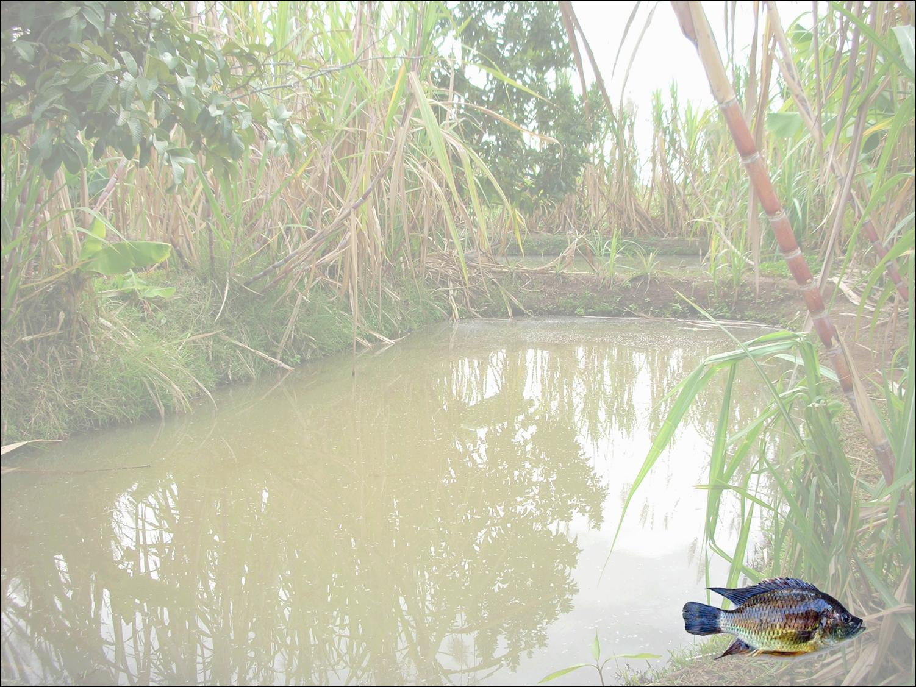
Aquaculture Options
There are large scale opportunities in cage culture of tilapia in major African lakes where site allocation and environmental management regimes can be established – this is underway.
In coastal zones large scale pond culture of shrimp could be feasible but only if well integrated and designed for low impact.
The hatchery and feed production sectors could provide small to medium scale opportunities in many areas. Also supply of equipment and technical services.
Other marine species including fish, mussels, oysters, seaweeds, and sea cucumber, together with freshwater species such as African catfish, and other local indigenous stocks could also be considered, but as smaller scale initiatives.
Introduction of non-native stocks would be politically problematic, and could encounter market problems, particularly for export.
An integrated/diversified approach could be considered, but would require good partners and localised management.
Notes:
large scale - opportunities in cage culture of tilapia in lakes Victoria and Volta in particular – Patrick SON and lake harvest
Ponds at coast – starting …. Moz, Namibia etc
Seeds and Feed – option to link marktes
NEW species in marine….
integrated/diversified approach - building up critical mass
Overall – moving from relatively undeveloped to a more recognisable sector
Remember the 3% figure !!!!!
Lake harvest is the BIGGEST!

Slide 17
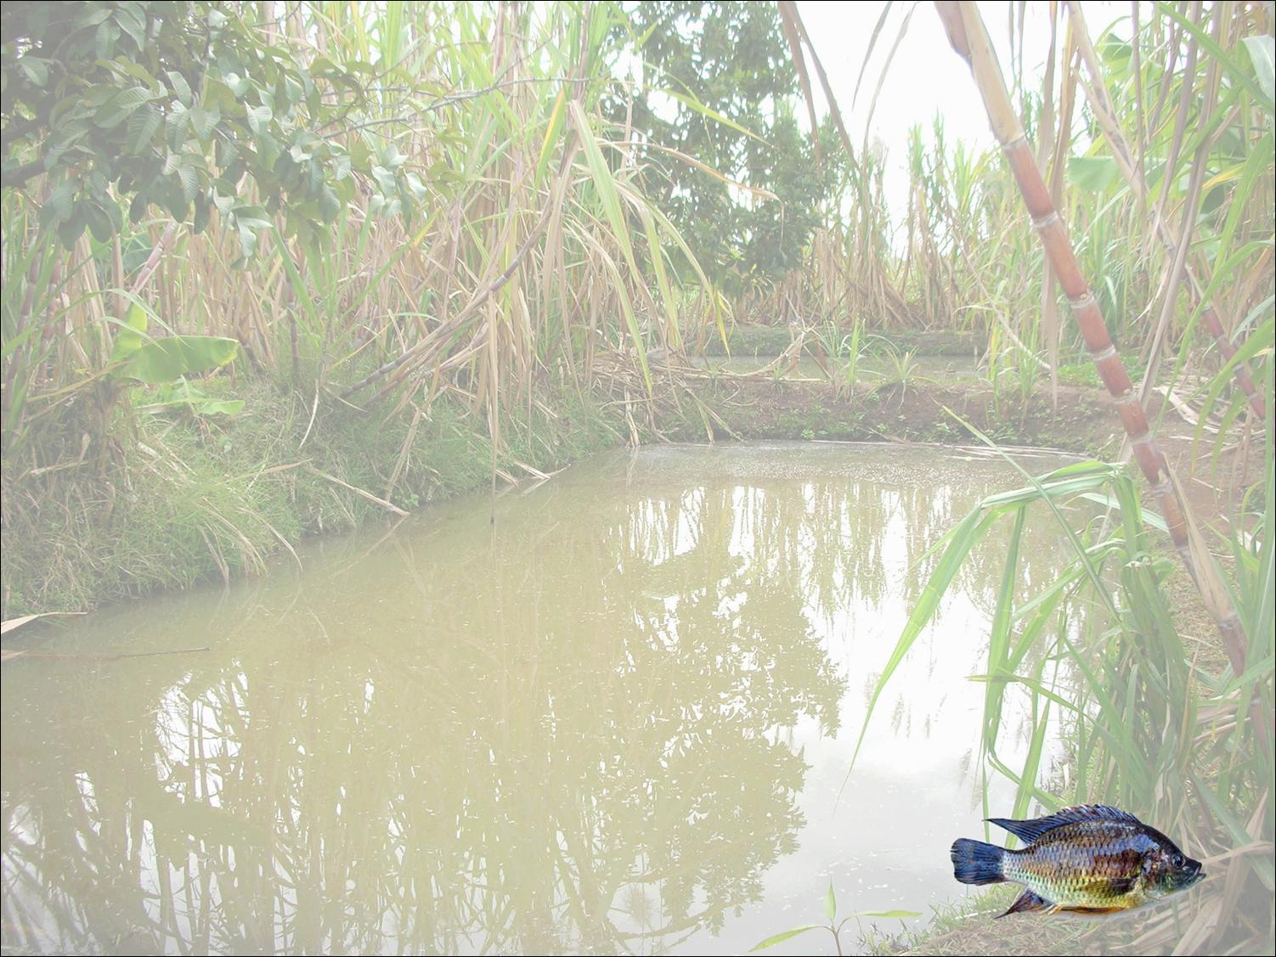
Value Addition
Opportunities are more difficult to place due to uncertainties of supply from fished (mainly marine) stocks, and problems of developing effective management regimes
This may improve, but not quickly - makes it difficult to justify new investment in major resources.
Better options may be associated with aggregating supplies from artisanal sources, often with community networks
Regional and international markets can be considered – access to Middle East and Asian, as well as European/US markets also has potential
Certification - could also consider linking this eco-labelling and fair trade approaches to develop specific source/brand identity
Value addition for aquaculture, possibly integrated approaches, could be useful, and could make capture fisheries linked enterprises more profitable.
Notes:
Improving value and quality from artisanal
New specific niche products for export or local
Potential for labeling – big issue of certification – voluntary and non-voluntary …. Good potential here and quality issue
3 dimensions to value addition – product , market areas and chain relationships

Slide 18
Partnerships
A range of business or development partners can be identified at different levels, in each country reviewed.
Many of these are undercapitalised, with varying skill and capacity levels but have excellent networks and interactions within national business and political contexts.
Usually very important, and the status of partners locally has to be considered carefully. Access to land, water, permits often critical.
In some cases, links with emerging community development and resource management entities are potentially valuable and business/NGO and other partnerships would be effective.
Innovative approaches could be appropriate to initiate and develop these types of partnership, eg linking CSR with commercially viable outcomes.
Mechanisms for establishing partnerships are usually straight-forward and often encouraged by national governments/ investment agencies.

Slide 19
National Perspectives
Tanzania – good coastal resources but long lead-in period required and environmental sensitivity is critical; inland has less potential. Infrastructure improving; markets need to develop; smaller-scale community initiatives important. Zanzibar has similar features. Joint marine resources strategy may improve value addition options.
Mozambique – very good coastal and inland natural resources, but management issues unlikely to be quickly resolved; improving market access but needs build-up and strong local or regional linkages; community developments also important;
Ghana – good prospects for aquaculture in L Volta, and for its support and marketing; value addition from coastal resources is possible but constrained by resources – uncertainties on future management.
Uganda – good prospects for aquaculture in L Victoria and others; good processing and other infrastructure; useful partners; but further seed and feed development needed for full commercial scale output.
Notes:
Tanzania
Artisanal and nile perch
Canning (sardine) value added for export
Gear and trucks
Pond fish farming
Branding and labeling
Mozambaiuqe
Prawns and tuna
Large scale shrimp / prawns
Post harvest processing esp artisanaal
Branding
Ghana
Cage culture, excellent potnetial large or simple cages
Hatchery
Fry and fingerling
Value added – tuna products or tilapia – filleting
Nigeria – linked markets
Uganda
Cage culture – patriick
Value adding

Slide 20
 | Short term | Long term
Small investment, typically USD 20-100,000 | Ghana Specialist fish feeds Community support services for aquaculture Mozambique Coastal/artisanal added value Tanzania Coastal/artisanal added value Shrimp/marine species hatchery Uganda Specialist Nile Perch/other by-products Specialist fish feeds Community support services for aquaculture Aquaculture equipment and technical services | Ghana Artisanal added value development Specialist hatchery Commercial support services for cage aquaculture Mozambique Fish feed development Tilapia and other species hatchery Diversification into aquaculture Tanzania Fish feed development Tilapia and other species hatchery Cage farming Uganda Commercial support services for cage aquaculture Specialist hatchery
Large investment, typically USD 500,000 plus. | Ghana Crystal Lake tilapia cage farm New cage farm development Fish feed development Tilapia hatchery development Mozambique n/a Tanzania n/a Uganda Specialist fishery by-products Fish feed development Tilapia hatchery development Source of the Nile tilapia cage farm New cage farm development | Ghana Aquaculture added value development Mozambique Fish feed development Tilapia and other species hatchery Shrimp/integrated aquaculture Tanzania Fish feed development Tilapia and other species hatchery Cage farming Shrimp/integrated aquaculture Uganda Aquaculture added value development Regional Tilapia cage culture, integrated with hatchery, feeds Equipment, business and technical services
Notes:
This table is explained fully in chapter 7 –
The investment opportunities defined are based on conventional expectations of establishing sound and sustainable businesses.
The next sections provide more specific explanation on how the selection criteria relate to these, and more detail on key investments.
Change points
Strategic approaches and responses to these
The type and scale of opportunities
Enterprise type and scale by country
Primary options for business development
Partners we identified

Slide 21
Regional Approach
Opportunities for an international scale, regionally based, globally-competitive commercial development? E.g. serving major world markets with strong array of products…
Needs significant production base, good management potential and significant value addition, with strong links to key retail/food service markets, securing major competitive position
Could operate across capture fisheries, aquaculture and more widely in supply and value chain… may need a ‘cash cow’ to generate core revenues and fund areas of future profitability
Not too many immediate prospects … some fishing companies had attempted, but either regional and politically constrained and/or capital-limited, or international, but mainly based on sourcing raw material;
Possible option for aquaculture – e.g. based on large African lakes, together with infrastructure and market development – e.g. production 20-50,000t at FSV of $30-80 million in first instance
Ghana and Uganda potentially strong resource bases for this … also Zimbabwe, S Africa, others – can also link with emerging value addition in coastal fisheries to secure a wider product base

Slide 22
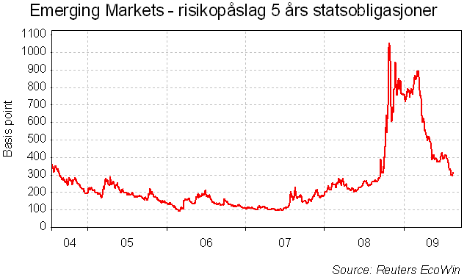
How about the financial crisis – will it stop investments?
We believe in normalisation. Good return on investment among internationally focused Norwegian companies have contributed to improved cash flow. The credit market has stared working again.

Slide 23
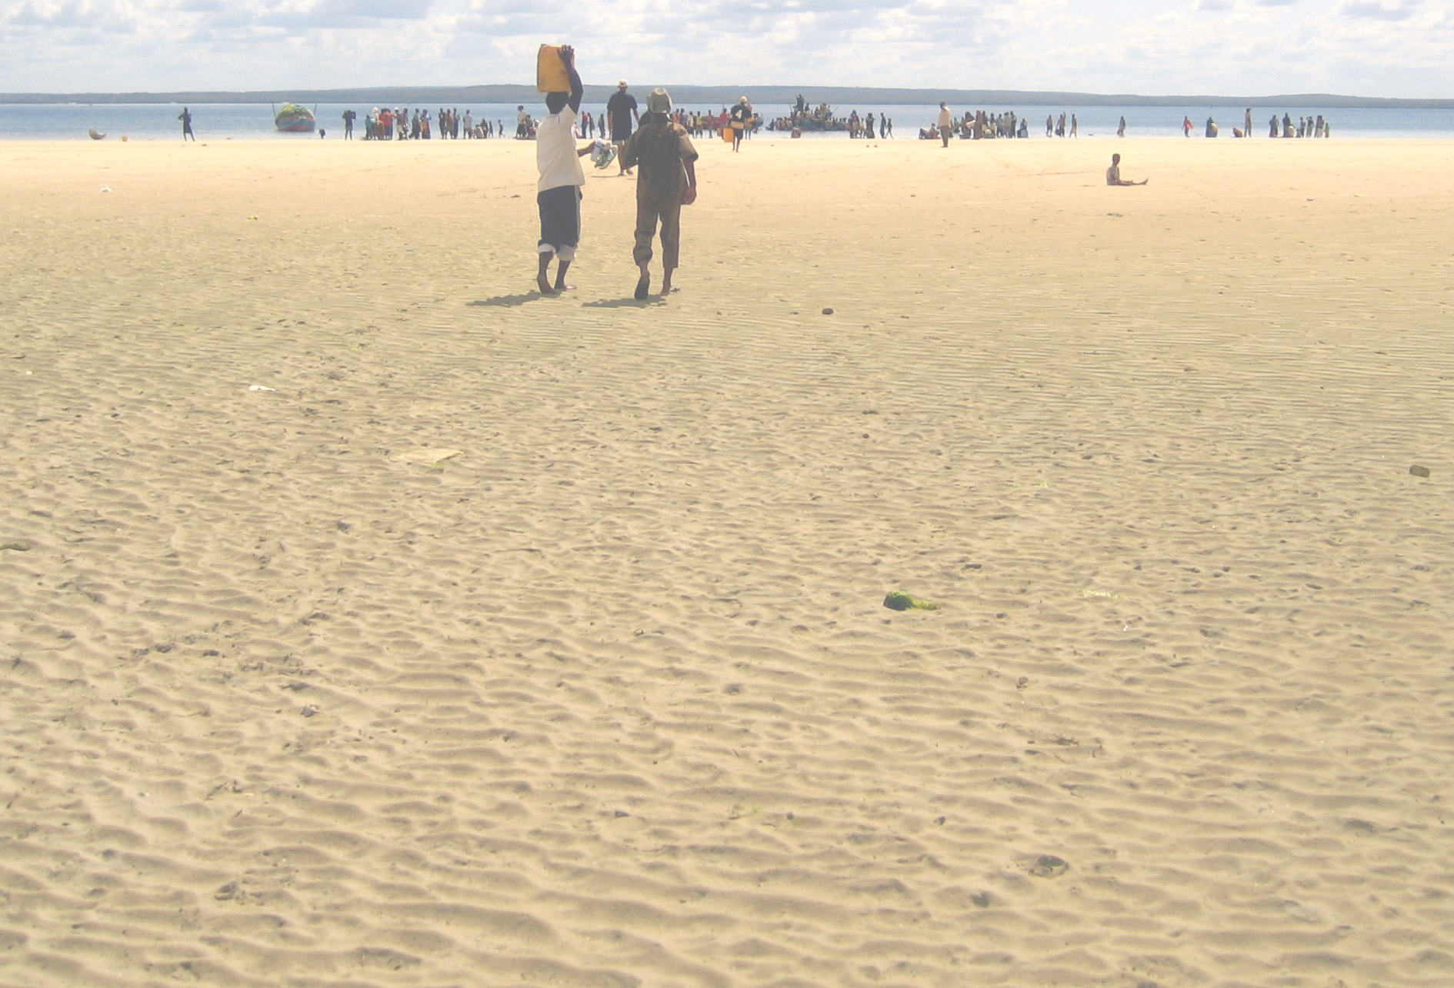
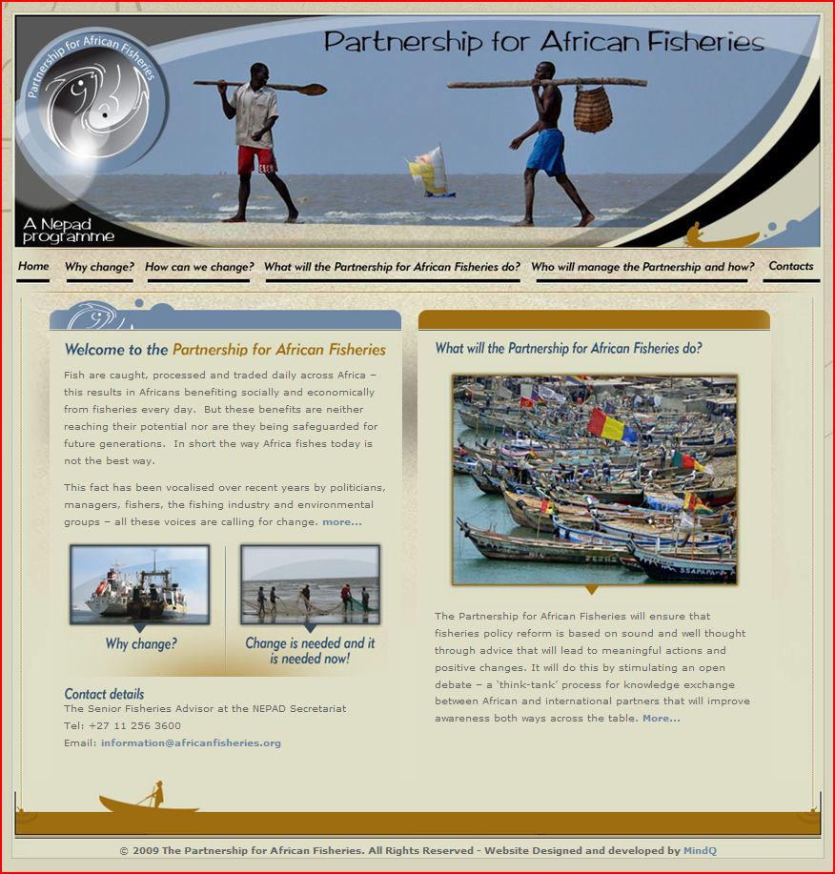
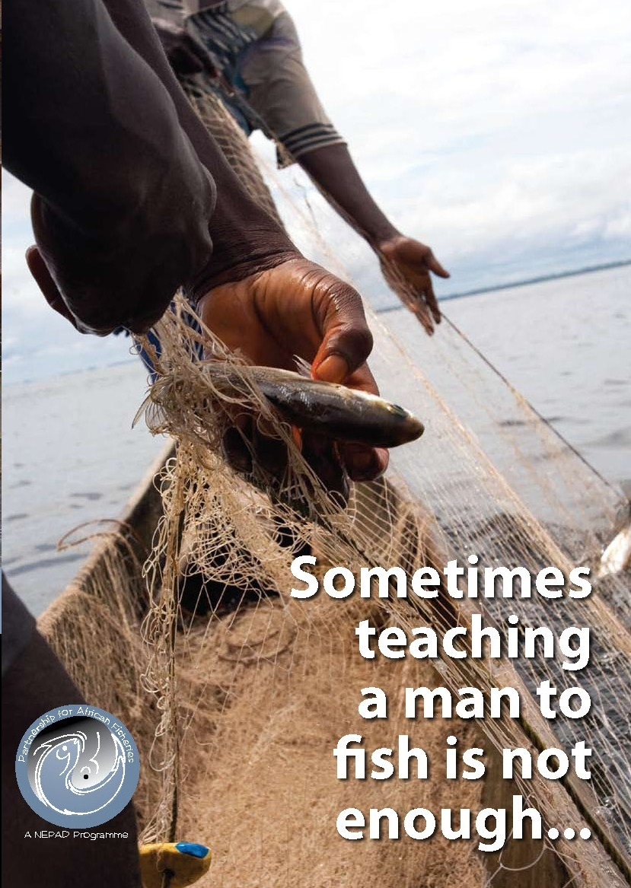
Change

Slide 25


Slide 26

Investment in Africa has often been a matter of
risk and adventure, great hopes, and uncertain paths
either to losses or occasionally great gains;
investment in the fishery sector has been somewhat similar.

